Slide 1
Intro to Neural Networks
Notes:
https://towardsdatascience.com/conv2d-to-finally-understand-what-happens-in-the-forward-pass-1bbaafb0b148

Slide 2
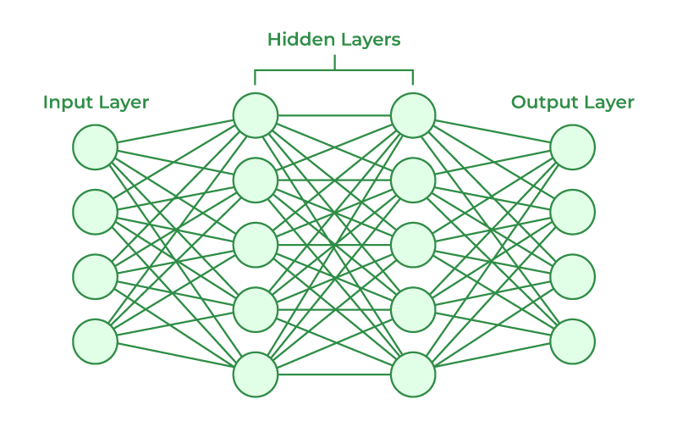
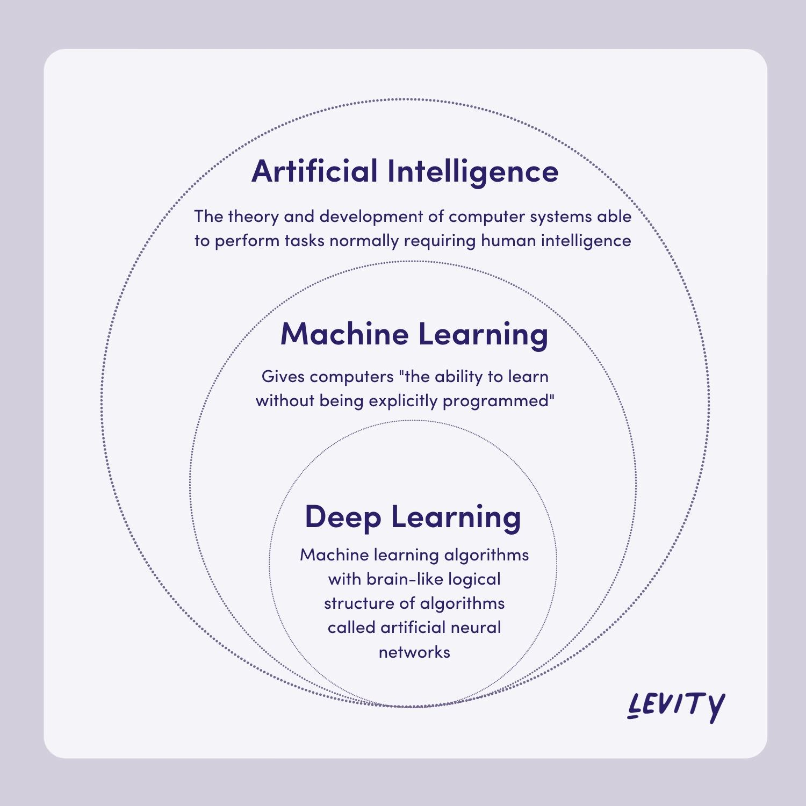
Deep Learning
Deep Learning is a subset of machine learning much more efficient for analyzing large datasets and finding patterns
Basis of deep learning: neural networks, designed to emulate the human brain
Deep Neural Networks - multiple layers of interconnected nodes
Basic Neural Networks consist of three parts: input layer, hidden layers, and output layer
Forward propagation - progressive computations as inputs are passed into model and gradually refined
Back propagation - how neural networks use output to train/update weights
Notes:
Ananya

Slide 3
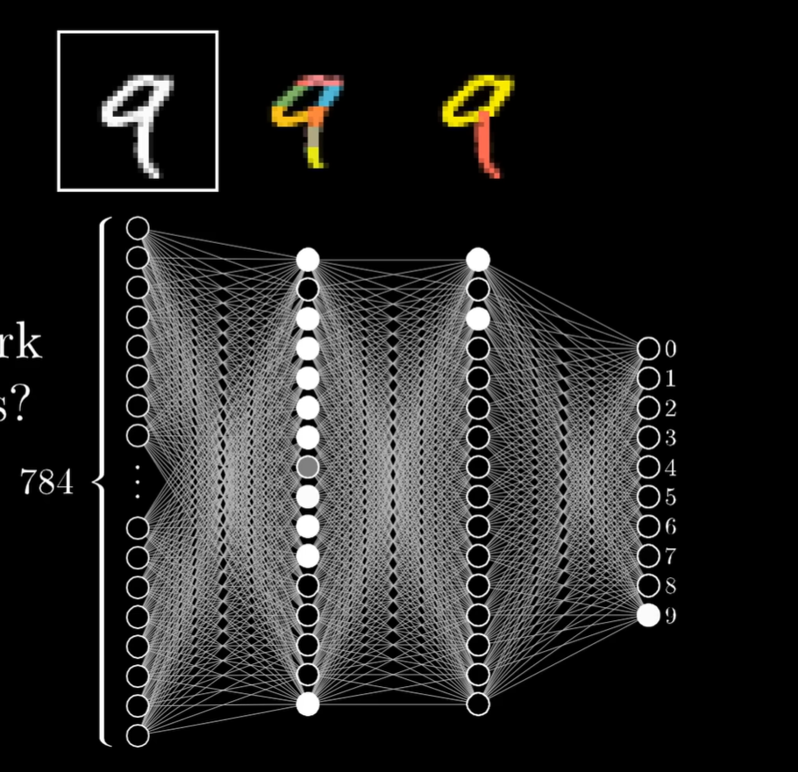
What are Neural Networks
Each layer has different set of weighted sum functions to understand parts of the dataset with increasing levels of abstraction (e.g. pixels -> edges -> patterns -> digits)
Move through the layers until reaching output layer, where the one with the highest activation is displayed as output
A neural network learns through back propagation, where network re-analyzes dataset again to finetune weights and biases
Boosts accuracy, enables complex pattern recognition, mimics “sentience”
Notes:
Roneet

Slide 4
What are Neural Networks
Several techniques to initialize weights for optimizing accuracy
Weights are compressed to a certain range (common normalization = sigmoid function)
Activation of node in second layer determined by computing weighted sum (activation of first layer node * corresponding connection weight)
A node’s activation state can be controlled by introducing bias
Only if activation > 0.7, move on to next layer
Notes:
Roneet

Slide 5
Biological Inspiration
Behaves like neurons in the brain
“A neuron’s output is a response to a question influenced by ‘weighted’ opinions of its inputs”
“Weights are akin to the strength of synapses between neurons”
“Just like humans strengthen memory with repetition, neural networks adjust weights to better recognize data”
Notes:
Roneet

Slide 6
More About Neural Network Structure

Slide 7
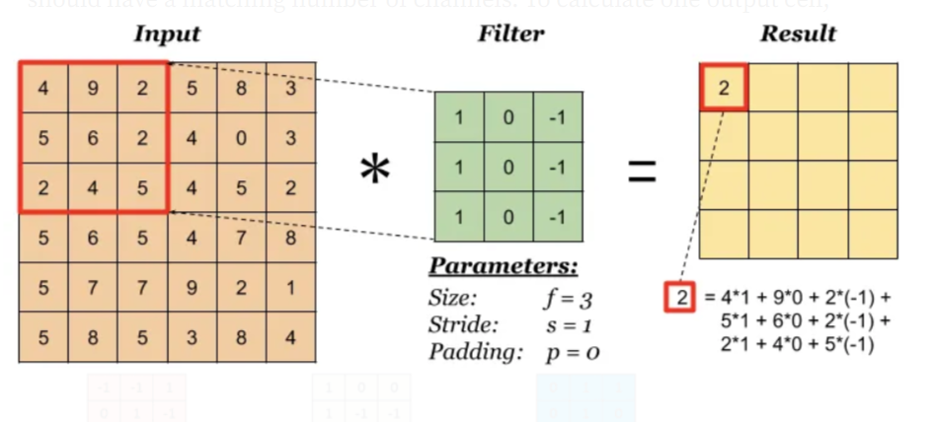
Convolutional Layers
The convolutional layer computes a dot product between the kernel, or sliding window, and the image pixel values. As shown in the gif below, the square in green is called the kernel, and the 9 by 9 square contains the image pixel values.
A Convolutional Layer Consists of various parameters:
Kernel size: the size of the sliding window
Stride: the number of squares the kernel will slide through each step of the convolution
Notes:
Anisha

Slide 8
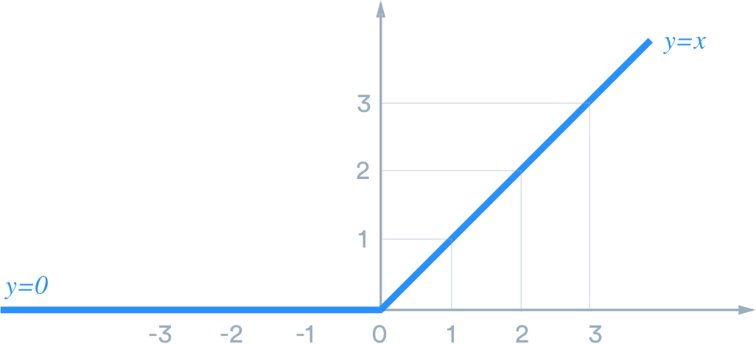
Activation Function: ReLU
Activation Function - nonlinearities between linear/convolutional layers of the model
Any linear network = can be represented as just one layer
ReLU: Common activation function
f(x) = max(0,x) - if a calculated value is negative, make it zero
Notes:
Ananya

Slide 9
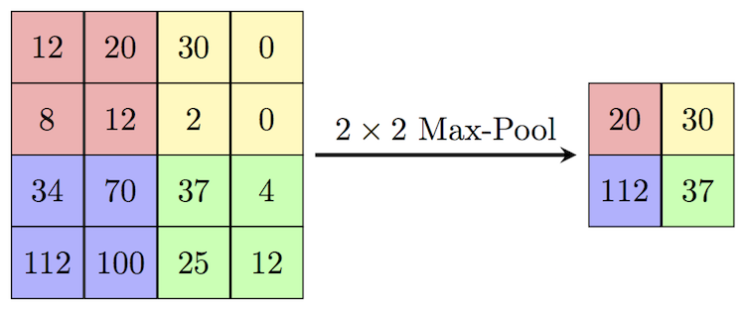
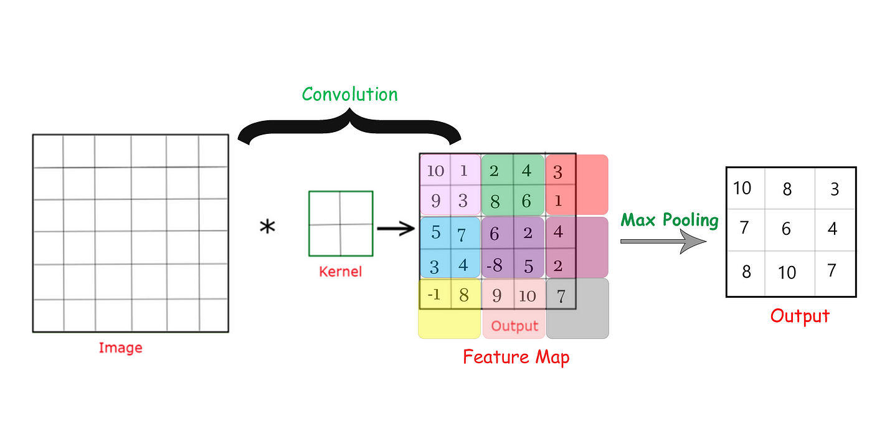
Max Pooling in Neural Networks
Technique that calculates maximum value from sections of a feature map (intermediate output)
Reduces dimensionality, often used after convolutional layer to account for small differences in image presentation
Intuition is to make model insensitive to small shifts (in the case of MNIST, small shifts in the handwritten number).
Notes:
Ananya

Slide 10
Training: Loss
Training Loss: measure of how well model performs
Loss we use in our coding example: Cross Entropy Loss, commonly used for classification purposes (model tries to minimize)
Back propagation
Method that calculates gradients of loss with respect to each of model weights in order to train through the process of gradient descent
Loss.backward() command
Can think of it as a “rippling” effect
Notes:
Anisha

Slide 11
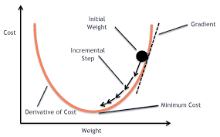
Gradient Descent
Gradient Descent:
A technique used to find the values of a function’s parameters that minimize the cost of the function
Essentially finding the local minimum of a function
Notes:
Anisha

Slide 12
Training: Optimization
Optimization is the process by which the weights of the model are actually updated
This occurs after the loss is computed and the gradients are calculated
The most common algorithm for optimization is the SGD, or Stochastic Gradient Descent
Notes:
Ananya

Slide 13
Dataset and Dataloaders
A dataset defines the pre-processing of the data in an organized manner, while the data loader iteratively loads data based on certain parameters - useful abstractions for deep learning
Performs necessary data augmentation
Data Loaders allow us to sample different chunks of our dataset with built in batching
Notes:
Anisha

Slide 14
Neural Network - Background about MNIST

Slide 15
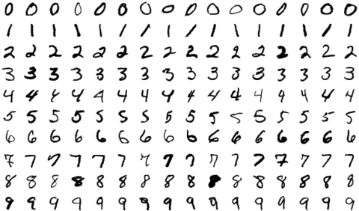
MNIST database
MNIST database: large dataset of handwritten digits
Commonly used to train image processing systems
70,000 images that can be used for model training and testing
Notes:
Anisha and Ananya

Slide 16
Neural Network - Applications

Slide 17



Basically Everywhere…
Notes:
Roneet

Slide 18
When to Not Use Neural Networks
Simple outcomes (yes/no, numerical, categorical)
Small dataset
Need for clear presentation
Neural network data not easy to interpret always and not always optimal for specific settings (showing average person a list of recommendations)
Notes:
Roneet

Slide 19
What Are Neural Networks
Behave like neurons in the brain
A layered process to dissect data
A node is a datapoint in a dataset with an “activation number” which triggers a function
A set of nodes forms a layer
Input, hidden, output
Layers are connected because each node in second layer uses characteristics from first layer as parameters to compute its activation output (has a different purpose)
The parameter for each node in the previous layer is known as a weight (a coefficient to influence specific characteristics in a dataset to analyze)
Notes:
Roneet

